Slide 1
A REDUX-INSPIRED PODCAST APP
JEEVANA SHRI C
712822104702

Slide 2
OBJECTIVES
The primary objective of the Podcast App project is to develop an innovative, user-centric platform that provides seamless access to a wide variety of podcasts while enhancing the listening experience with personalized features and monetization options for creators. This app aims to cater to both casual listeners and serious podcast enthusiasts by offering a feature-rich, intuitive, and engaging environment.
1. Provide Easy Access to Diverse Content
To offer a vast library of podcasts across multiple genres (e.g., news, comedy, business, education, true crime) with advanced search and discovery tools.
2. Enhance User Experience with Personalization
To integrate smart algorithms that recommend podcasts based on user preferences, listening history, and trending topics.
3. Develop Seamless Playback Features
To implement user-friendly controls for podcast playback, including options for variable speed, skip/rewind, offline listening, and bookmarking favorite episodes.

Slide 3
DESCRIPTION
What is Podcast Plus?
Podcast Plus is an advanced podcast app designed to provide users with a premium, feature-rich podcast experience.
Combines features like ad-free listening, exclusive content, personalized recommendations, and advanced playback controls, all in one app.
The Need for Podcast Plus
Growing demand for more control over podcast consumption.
Users want a more immersive, personalized, and premium experience.
Ad-Free Experience
Enjoy uninterrupted listening with no ads between episodes.
Exclusive Content
Access to premium episodes, special series, and early releases from top creators.
Offline Listening
Download episodes for offline access, perfect for road trips, flights, or areas with limited connectivity.
Advanced Playback Controls
Adjust speed, skip silence, set a sleep timer, and enjoy seamless transitions between episodes.

Slide 4
FUNCTIONALITIES
The Podcast App is designed to provide a seamless, personalized, and engaging podcast experience for users while offering monetization and growth opportunities for creators. Below are the key functionalities that will ensure the app meets user needs and stands out in the competitive podcast space:
Subscription & Follow Feature
Podcast Subscriptions: Users can subscribe to their favorite podcasts, ensuring they receive automatic updates when new episodes are released.
Notifications: Push notifications alert users to new episodes, exclusive content, or live events.
Playback Controls & Customization
Playback Speed Control: Users can adjust playback speed (e.g., 1.0x, 1.5x, 2.0x) based on preference.
Skip/Replay Controls: Users can skip forward or rewind a set number of seconds to navigate to key moments in an episode.

Slide 5
ADDITIONAL
REQUIREMENTS
1. Performance & Scalability Requirements
High Availability & Reliability:
Implement redundant systems and backups to prevent service interruptions.
2. Security & Data Privacy
User Data Protection:
Implement data encryption (SSL/TLS) both at rest and in transit to protect sensitive user data.
3.Payment Security:
Integrate secure payment gateways (e.g., Stripe, PayPal) for in-app purchases, subscriptions, and donations to protect financial transactions.
4. Advanced Audio Features:
Provide automatic or manual transcriptions of podcasts for accessibility and SEO purposes.
Include closed captioning or subtitles for video podcasts.

Slide 6
Main Activity.java:
package com.example.podcastplayer
import android.content.Context
import android.media.MediaPlayer
import android.os.Bundle
import androidx.activity.ComponentActivity
import androidx.activity.compose.setContent
import androidx.compose.foundation.BorderStroke
import androidx.compose.foundation.Image
import androidx.compose.foundation.layout.*
import androidx.compose.foundation.rememberScrollState
import androidx.compose.foundation.verticalScroll
import androidx.compose.material.*
import androidx.compose.runtime.*
import androidx.compose.ui.Alignment
import androidx.compose.ui.Modifier
import androidx.compose.ui.graphics.Color
import androidx.compose.ui.res.painterResource
import androidx.compose.ui.text.font.FontWeight
import androidx.compose.ui.text.style.TextAlign
import androidx.compose.ui.unit.dp
import androidx.compose.ui.unit.em

Slide 7
import androidx.compose.ui.unit.sp
import com.example.podcastplayer.ui.theme.PodcastPlayerTheme
class MainActivity : ComponentActivity() {
override fun onCreate(savedInstanceState: Bundle?) {
super.onCreate(savedInstanceState)
setContent {
PodcastPlayerTheme {
// A surface container using the 'background' color from the theme
Surface(
modifier = Modifier.fillMaxSize(),
color = MaterialTheme.colors.background
) {
playAudio(this)
}
}
}
}
}

Slide 8
@Composable
fun playAudio(context: Context) {
Column(modifier = Modifier.fillMaxSize()) {
Column(horizontalAlignment = Alignment.CenterHorizontally, verticalArrangement = Arrangement.Center) {
Text(text = "PODCAST",
modifier = Modifier.fillMaxWidth(),
textAlign = TextAlign.Center,
color = Color(0xFF6a3ef9),
fontWeight = FontWeight.Bold,
fontSize = 36.sp,
style = MaterialTheme.typography.h1,
letterSpacing = 0.1.em
)
}
Column(modifier = Modifier
.fillMaxSize()
.verticalScroll(rememberScrollState())) {

Slide 9
Card(
elevation = 12.dp,
border = BorderStroke(1.dp, Color.Magenta),
modifier = Modifier
.padding(16.dp)
.fillMaxWidth()
.height(250.dp)
)
{
val mp: MediaPlayer = MediaPlayer.create(context, R.raw.audio)
Column(
modifier = Modifier.fillMaxSize(),
horizontalAlignment = Alignment.CenterHorizontally
)
{
Image(
painter = painterResource(id = R.drawable.img),
contentDescription = null,
modifier = Modifier
.height(150.dp)
.width(200.dp),
)

Slide 10
Text(
text = "\uD83E\uDD2F Mariana Trench \uD83D\uDE30 உலகின் ஆழமான இடத்தில் என்ன இருக்கிறது? | Mr.GK",
textAlign = TextAlign.Center,
modifier = Modifier.padding(start = 20.dp, end = 20.dp)
)
Row() {
IconButton(onClick = { mp.start() }, modifier = Modifier.size(35.dp)) {
Icon(
painter = painterResource(id = R.drawable.play),
contentDescription = ""
)
}
IconButton(onClick = { mp.pause() }, modifier = Modifier.size(35.dp)) {
Icon(
painter = painterResource(id = R.drawable.pause),
contentDescription = ""
)
}
}
}
}

Slide 11
Card(
elevation = 12.dp,
border = BorderStroke(1.dp, Color.Magenta),
modifier = Modifier
.padding(16.dp)
.fillMaxWidth()
.height(250.dp)
)
{
val mp: MediaPlayer = MediaPlayer.create(context, R.raw.audio_1)
Column(
modifier = Modifier.fillMaxSize(),
horizontalAlignment = Alignment.CenterHorizontally
) {
Image(
painter = painterResource(id = R.drawable.img_1),
contentDescription = null,
modifier = Modifier
.height(150.dp)
.width(200.dp)
)

Slide 12
Text(
text = "Worst Nuclear Accidents in History",
textAlign = TextAlign.Center,
modifier = Modifier.padding(start = 20.dp, end = 20.dp)
)
Row() {
IconButton(onClick = { mp.start() }, modifier = Modifier.size(35.dp)) {
Icon(
painter = painterResource(id = R.drawable.play),
contentDescription = ""
)
}
IconButton(onClick = { mp.pause() }, modifier = Modifier.size(35.dp)) {
Icon(
painter = painterResource(id = R.drawable.pause),
contentDescription = ""
)
}
}
}
}

Slide 13
Card(
elevation = 12.dp,
border = BorderStroke(1.dp, Color.Magenta),
modifier = Modifier
.padding(16.dp)
.fillMaxWidth()
.height(250.dp)
)
{
val mp: MediaPlayer = MediaPlayer.create(context, R.raw.audio_2)
Column(
modifier = Modifier.fillMaxSize(),
horizontalAlignment = Alignment.CenterHorizontally
) {
Image(
painter = painterResource(id = R.drawable.img_2),
contentDescription = null,
modifier = Modifier
.height(150.dp)
.width(200.dp)
)

Slide 14
Text(
text = "Apple Monopoly \uD83D\uDE08 - இனிமே நாமதான் \uD83D\uDC51\uD83D\uDD25",
textAlign = TextAlign.Center,
modifier = Modifier.padding(start = 20.dp, end = 20.dp)
)
Row() {
IconButton(onClick = { mp.start() }, modifier = Modifier.size(35.dp)) {
Icon(
painter = painterResource(id = R.drawable.play),
contentDescription = ""
)
}
IconButton(onClick = { mp.pause() }, modifier = Modifier.size(35.dp)) {
Icon(
painter = painterResource(id = R.drawable.pause),
contentDescription = ""
)
}
}
}
}

Slide 15
Card(
elevation = 12.dp,
border = BorderStroke(1.dp, Color.Magenta),
modifier = Modifier
.padding(16.dp)
.fillMaxWidth()
.height(250.dp)
)
{
val mp: MediaPlayer = MediaPlayer.create(context, R.raw.audio_3)
Column(
modifier = Modifier.fillMaxSize(),
horizontalAlignment = Alignment.CenterHorizontally
) {
Image(
painter = painterResource(id = R.drawable.img_3),
contentDescription = null,
modifier = Modifier
.height(150.dp)
.width(200.dp),
)

Slide 16
Text(
text = "Innocence Betrayed \uD83D\uDC94 From Childhood Friends to Recent Heartbreak - The SS Podcast ft. Jayam Ravi",
textAlign = TextAlign.Center,
modifier = Modifier.padding(start = 20.dp, end = 20.dp)
)
Row() {
IconButton(onClick = { mp.start() }, modifier = Modifier.size(35.dp)) {
Icon(
painter = painterResource(id = R.drawable.play),
contentDescription = ""
)
}
IconButton(onClick = { mp.pause() }, modifier = Modifier.size(35.dp)) {
Icon(
painter = painterResource(id = R.drawable.pause),
contentDescription = ""
)
}
}
}
}

Slide 17
Card(
elevation = 12.dp,
border = BorderStroke(1.dp, Color.Magenta),
modifier = Modifier
.padding(16.dp)
.fillMaxWidth()
.height(250.dp)
)
{
val mp: MediaPlayer = MediaPlayer.create(context, R.raw.audio_4)
Column(
modifier = Modifier.fillMaxSize(),
horizontalAlignment = Alignment.CenterHorizontally
) {
Image(
painter = painterResource(id = R.drawable.img_4),
contentDescription = null,
modifier = Modifier
.height(150.dp)
.width(200.dp),
)

Slide 18
Text(
text = "Business vs Politics \uD83D\uDD25- அண்ணா வரார் வழி விடு \uD83D\uDC3F\uD83C\uDDEA\uD83C\uDDF8",
textAlign = TextAlign.Center,
modifier = Modifier.padding(start = 20.dp, end = 20.dp)
)
Row() {
IconButton(onClick = { mp.start() }, modifier = Modifier.size(35.dp)) {
Icon(
painter = painterResource(id = R.drawable.play),
contentDescription = ""
)
}
IconButton(onClick = { mp.pause() }, modifier = Modifier.size(35.dp)) {
Icon(
painter = painterResource(id = R.drawable.pause),
contentDescription = ""
)
}
}
}
}

Slide 19
Card(
elevation = 12.dp,
border = BorderStroke(1.dp, Color.Magenta),
modifier = Modifier
.padding(16.dp)
.fillMaxWidth()
.height(250.dp)
)
{
val mp: MediaPlayer = MediaPlayer.create(context, R.raw.audio_5)
Column(
modifier = Modifier.fillMaxSize(),
horizontalAlignment = Alignment.CenterHorizontally
) {
Image(
painter = painterResource(id = R.drawable.img_5),
contentDescription = null,
modifier = Modifier
.height(150.dp)
.width(200.dp),
)

Slide 20
Text(
text = "இதை பார்க்காதீங்க - Roko's Basilisk ",
textAlign = TextAlign.Center,
modifier = Modifier.padding(start = 20.dp, end = 20.dp)
)
Row() {
IconButton(onClick = { mp.start() }, modifier = Modifier.size(35.dp)) {
Icon(
painter = painterResource(id = R.drawable.play),
contentDescription = ""
)
}
IconButton(onClick = { mp.pause() }, modifier = Modifier.size(35.dp)) {
Icon(
painter = painterResource(id = R.drawable.pause),
contentDescription = ""
)
}
}
}
}
}
}
}

Slide 21
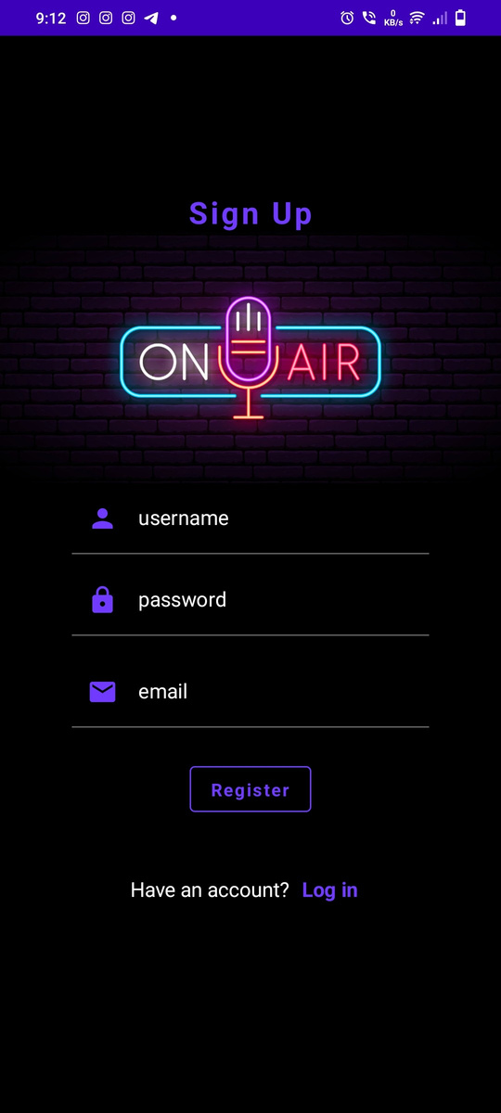
OUTPUT :

Slide 22
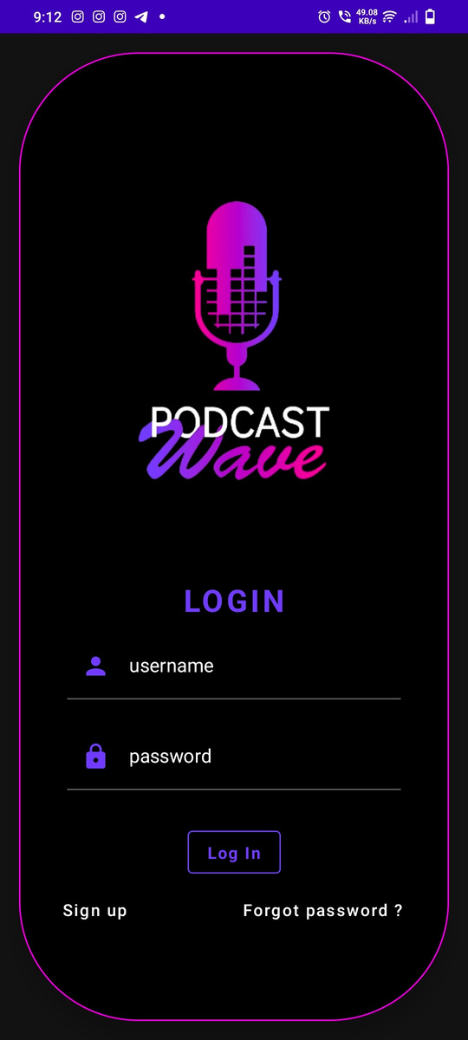

Slide 23
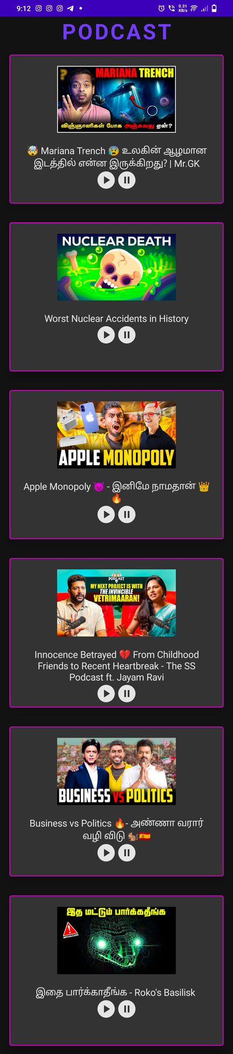

Slide 24
